Slide 1
Castleton
Year 4 residential
Tuesday 16th -April 18th April 2019

Slide 2
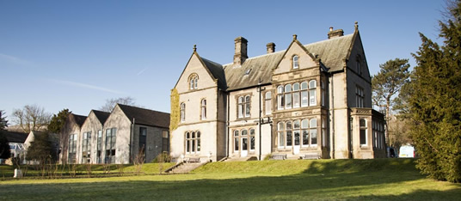
Losehill Hall
Losehill Hall is a historic Grade II-listed building in Castleton, Derbyshire.

Slide 3
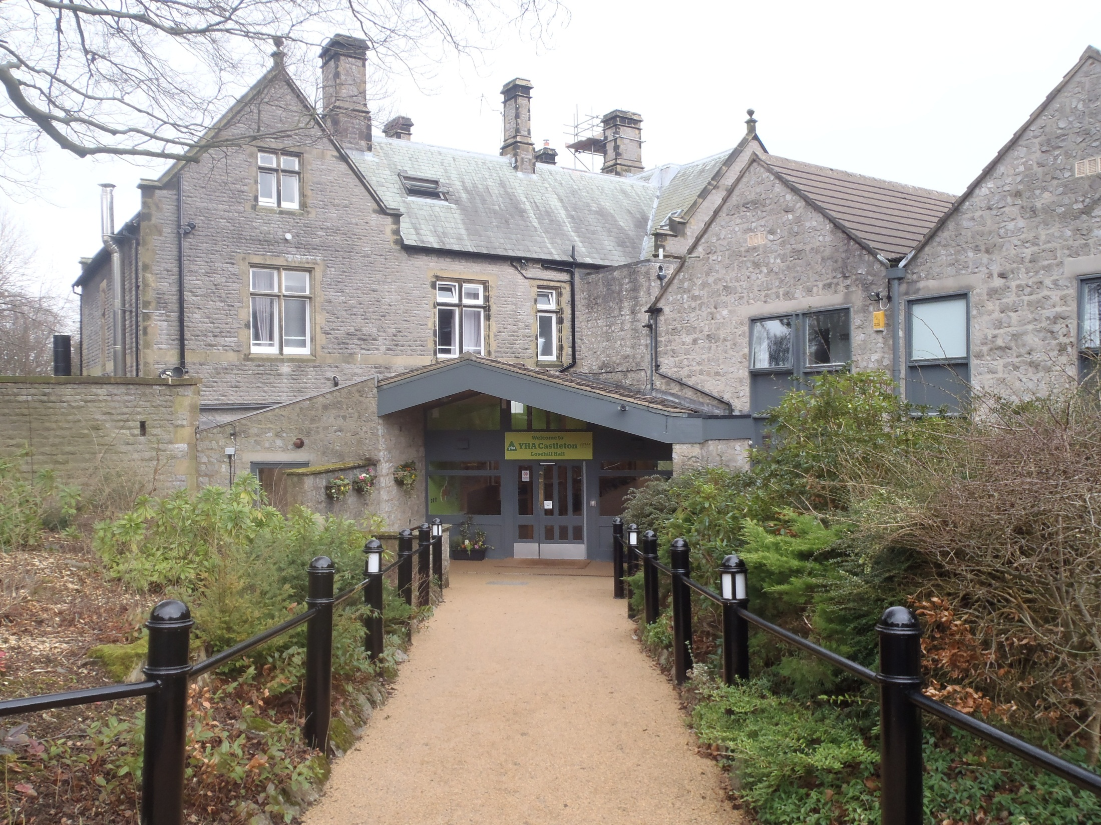

Slide 4
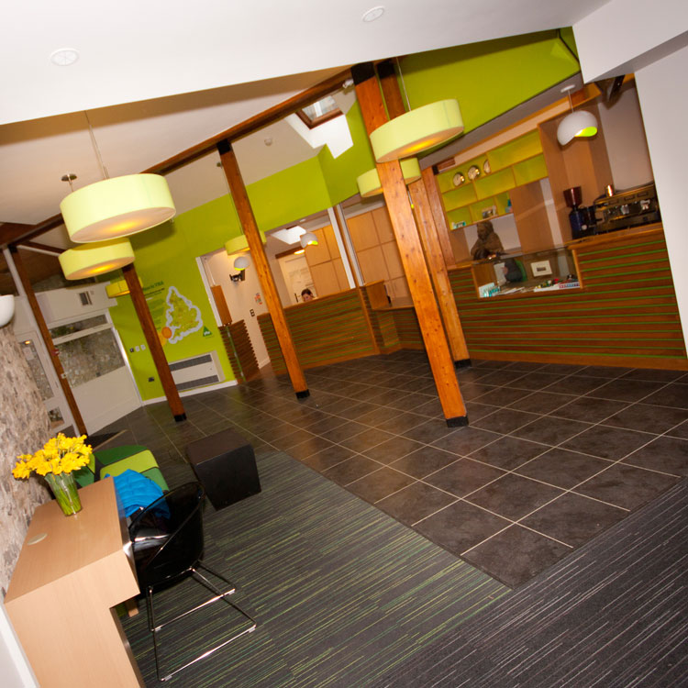
Old but new
The Youth Hostel
Association completed
an extensive £2 million
12-month refurbishment
project in February 2012.
.

Slide 5
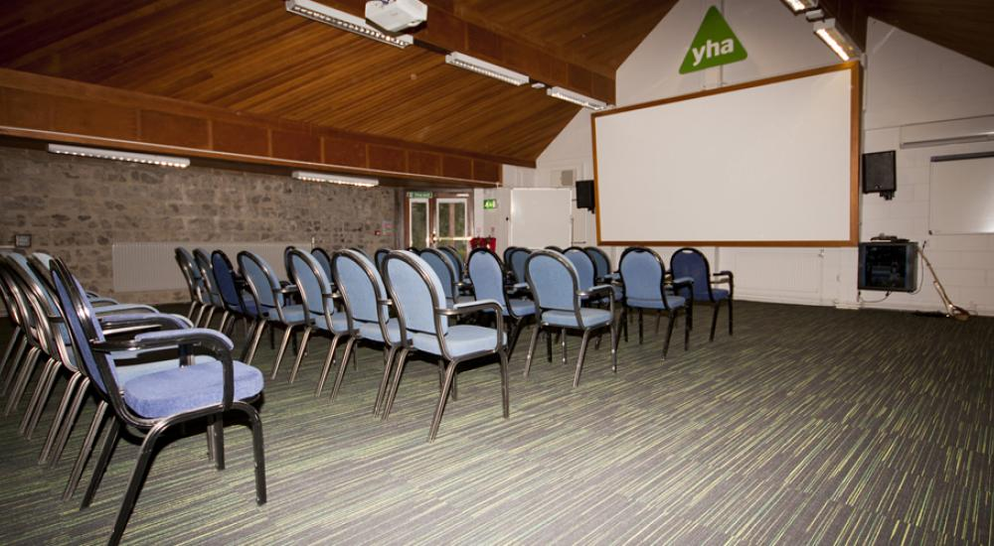
Purpose built

Slide 6
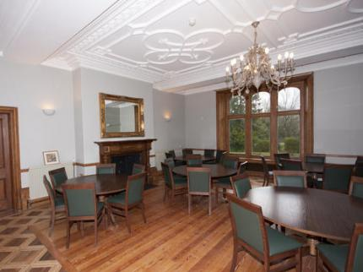
Retaining character

Slide 7
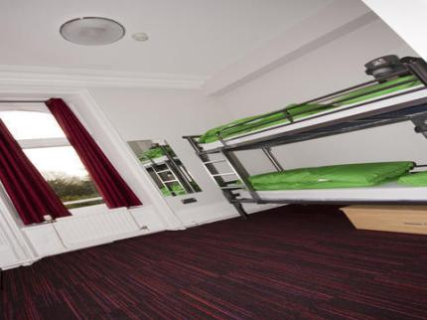
Quality rooms

Slide 8
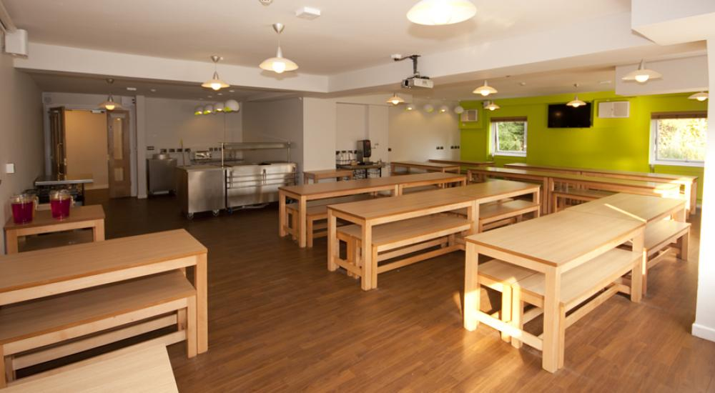
Dining together

Slide 9
More specifically
The activities experienced at Castleton bring our history topic to life and enrich it more than we could ever do in school.
Learning takes place both before, during and after the residential. Having hands on experiences result in better learning outcomes for all the children.

Slide 10
Health and safety
Complying with Sheffield Authority guidelines there will be a minimum ratio of 1 adult to every 10 children, YHA staff are additional to this
There are members of the YHA staff present 24 hours per day manning the main reception desk
The building site security operates via secure key cards
Losehill Hall meets all the current health and safety regulations
YHA staff are trained to run the specific activities and are all CRB checked and first aid trained
Children will always be accompanied by at least one member of school staff at all times
We do all of the activities on site apart from the history walk

Slide 11
Organisation 2
We do not allow mobile phones to be taken. In case of emergencies you are provided with contact numbers prior to the visit
Children sleep in same sex rooms of between 2 and 8. Teacher rooms are interspaced between the children’s rooms and are labelled on the door. Children are made aware of the nearest teacher room to their own.
Children get to choose who they want to share with, we try our best to accommodate all requests

Slide 12
Activities
Archery
Fossil casting
Candle making
Archaeological dig
Roman soldier training
History walk
Problem solving/ team building
Building a Roman siege engine
Hands on history
In the roundhouse
Karaoke
Egg rocket challenge
Mr Handleys bedtime story

Slide 13
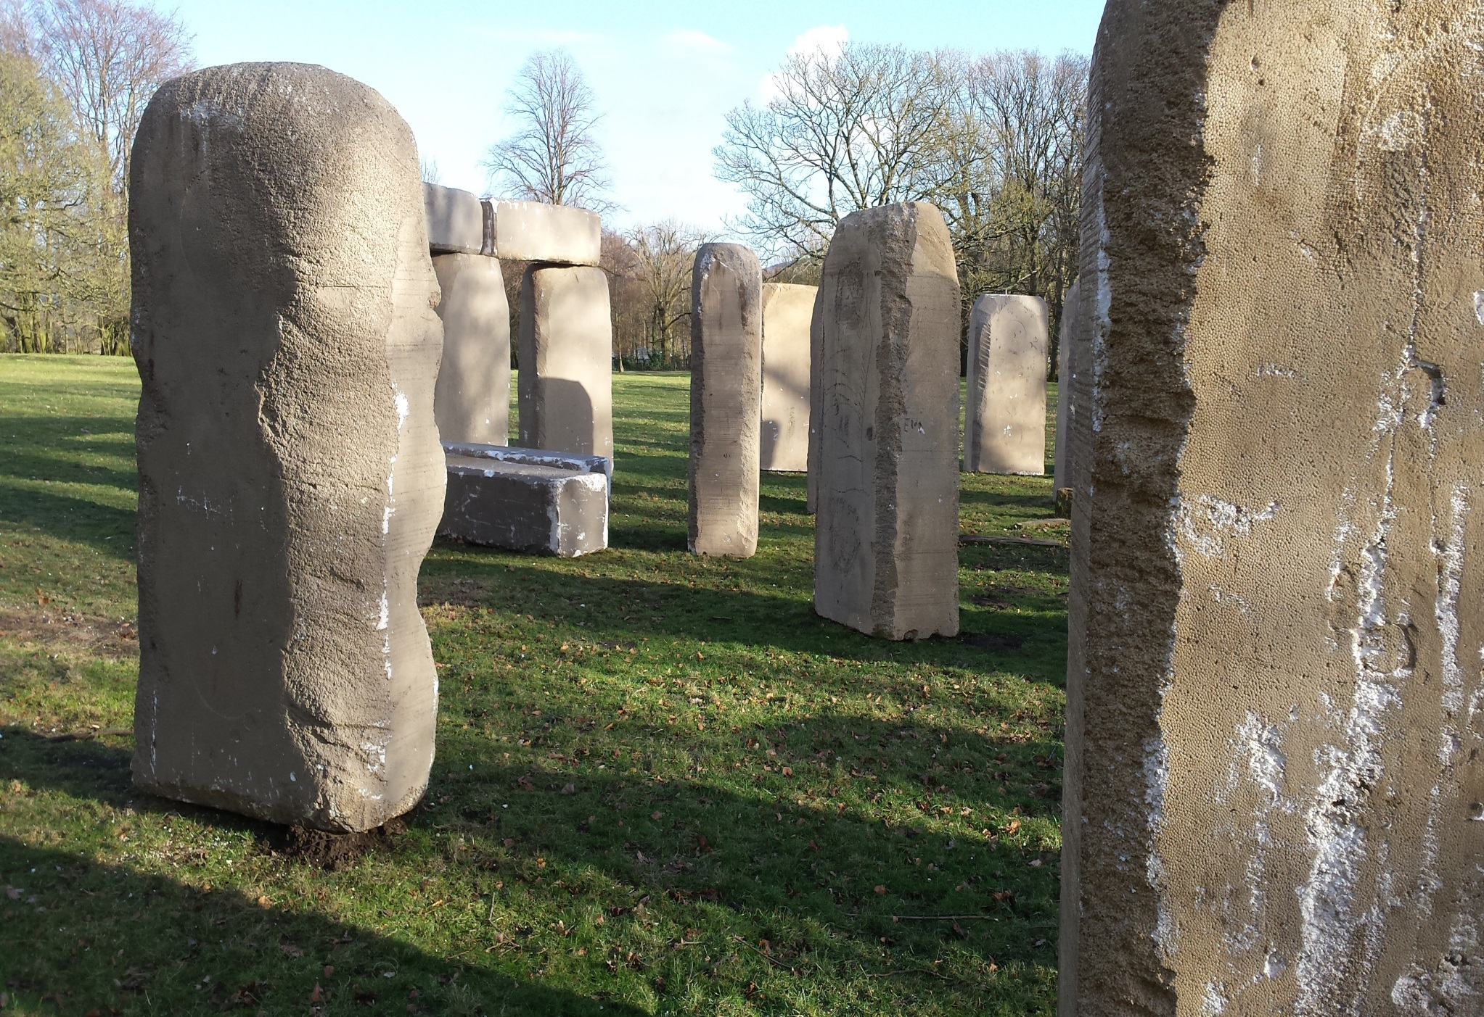

Slide 14
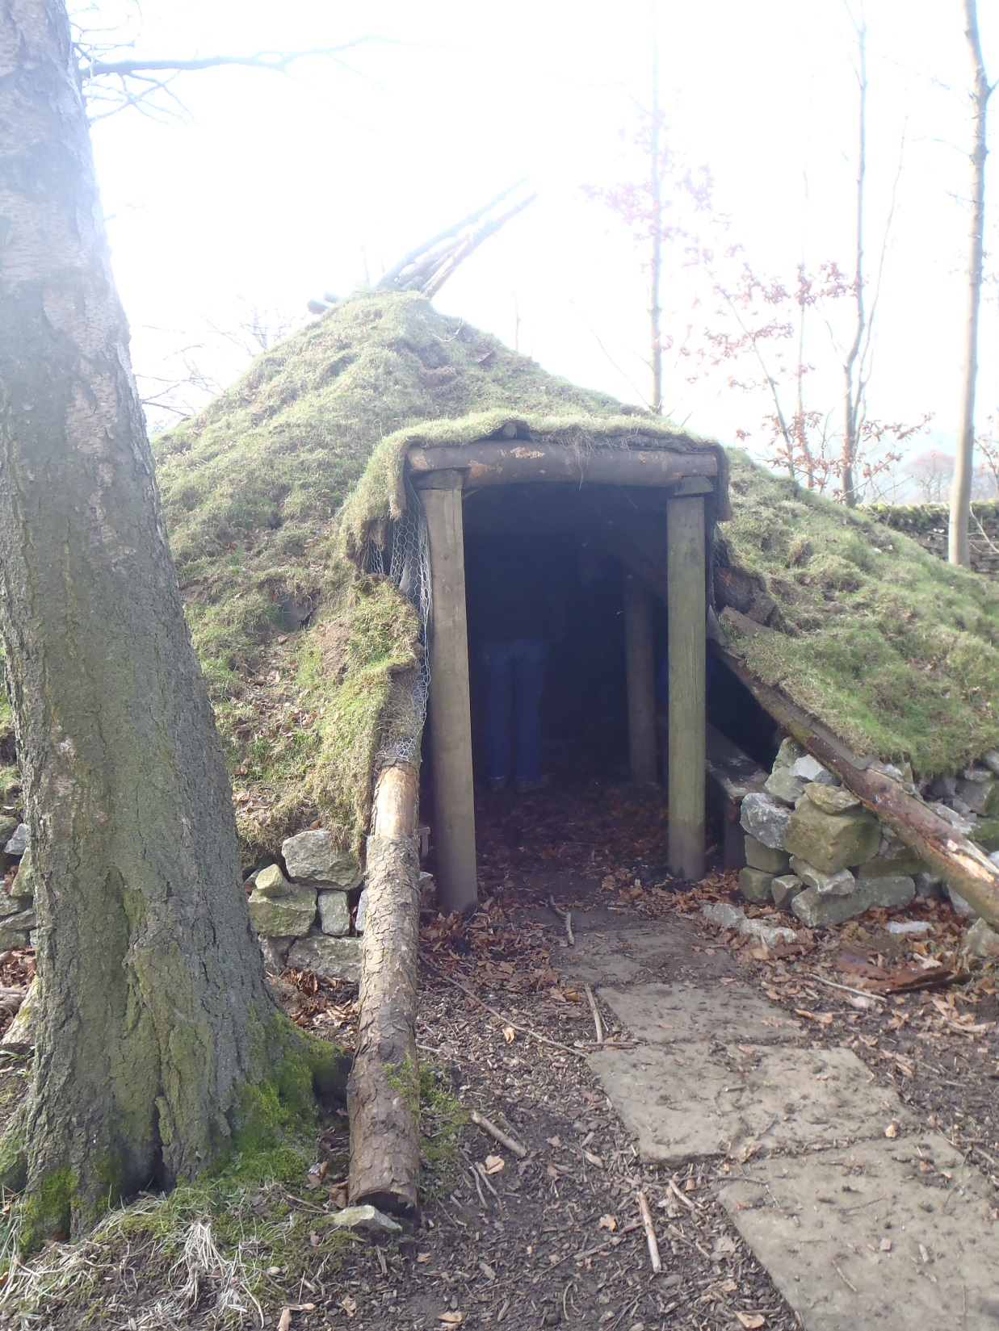

Slide 15
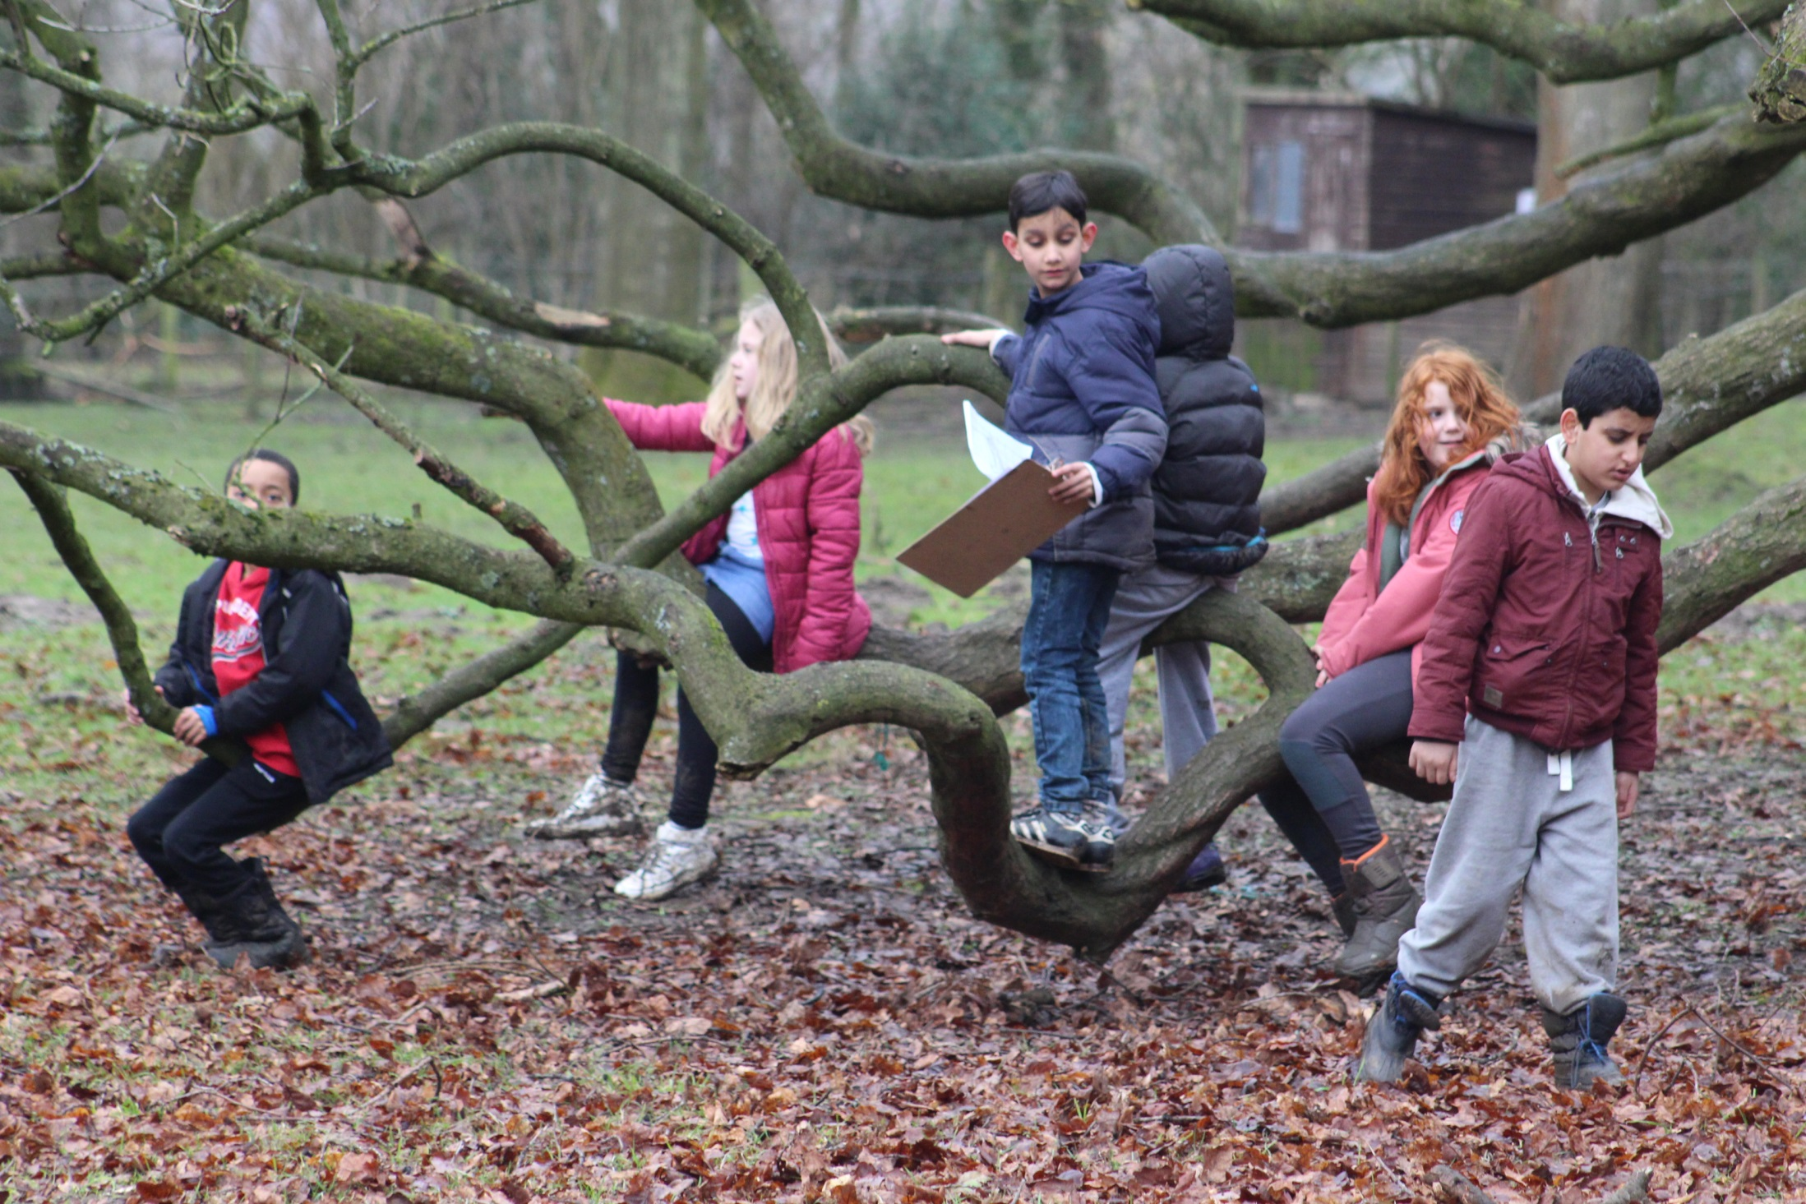

Slide 16
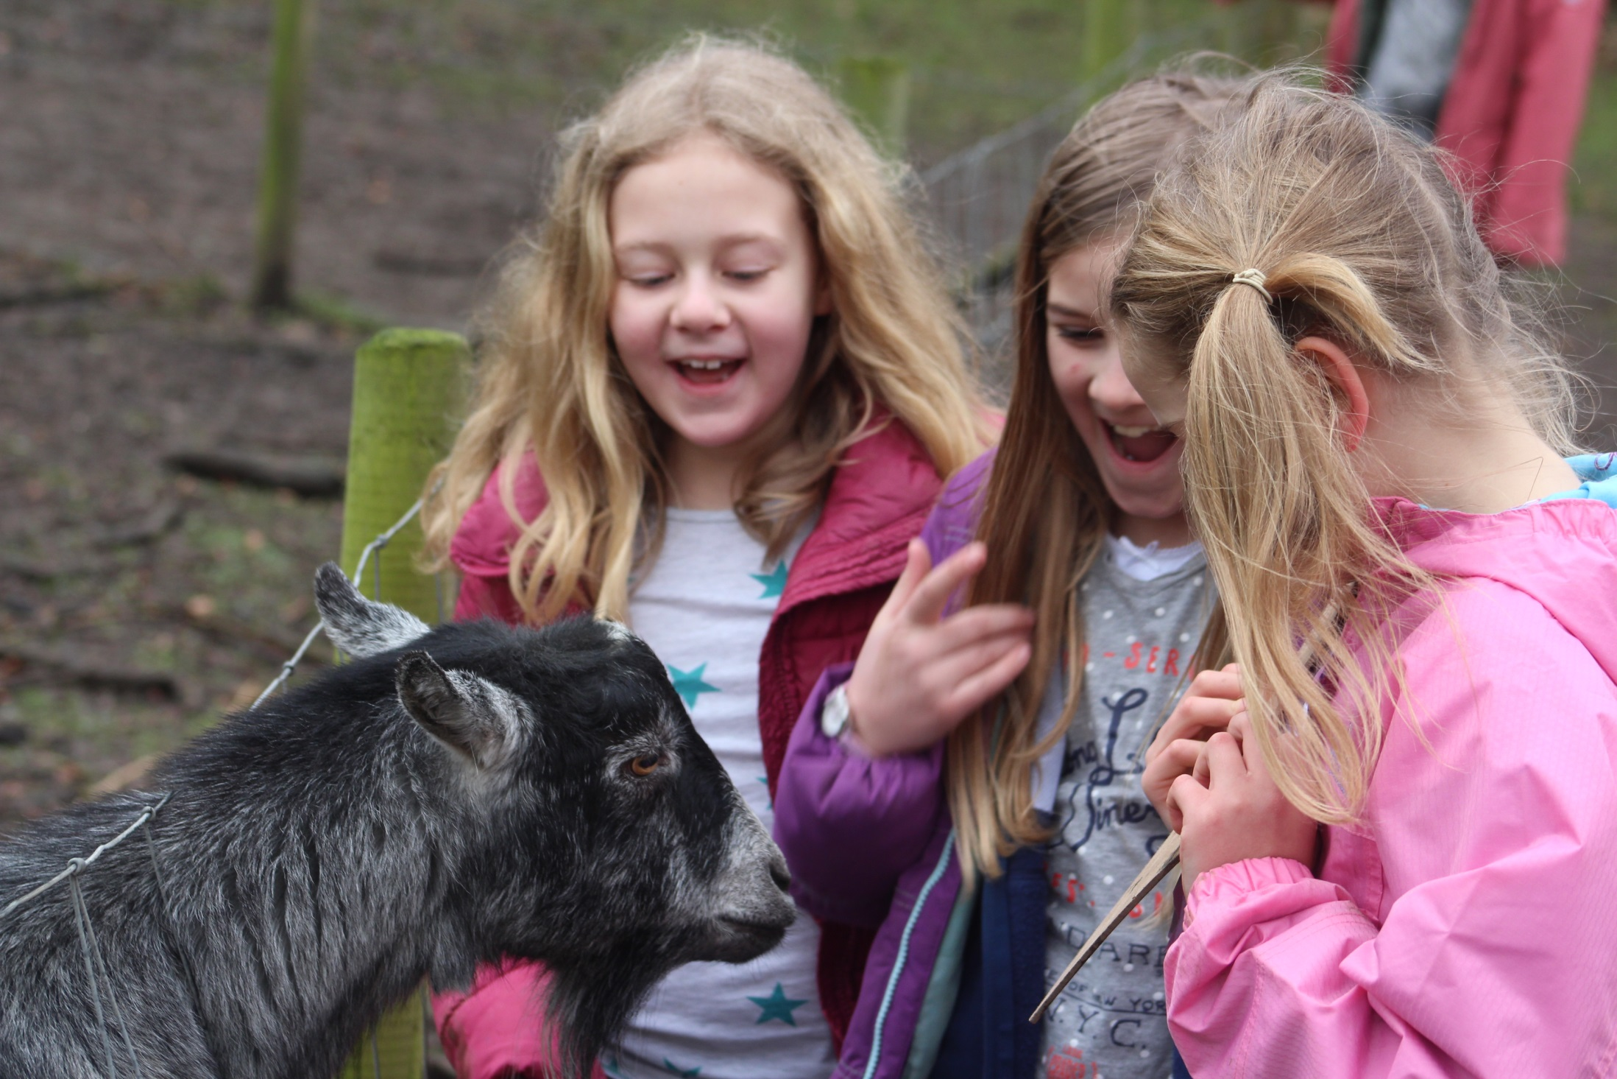

Slide 17
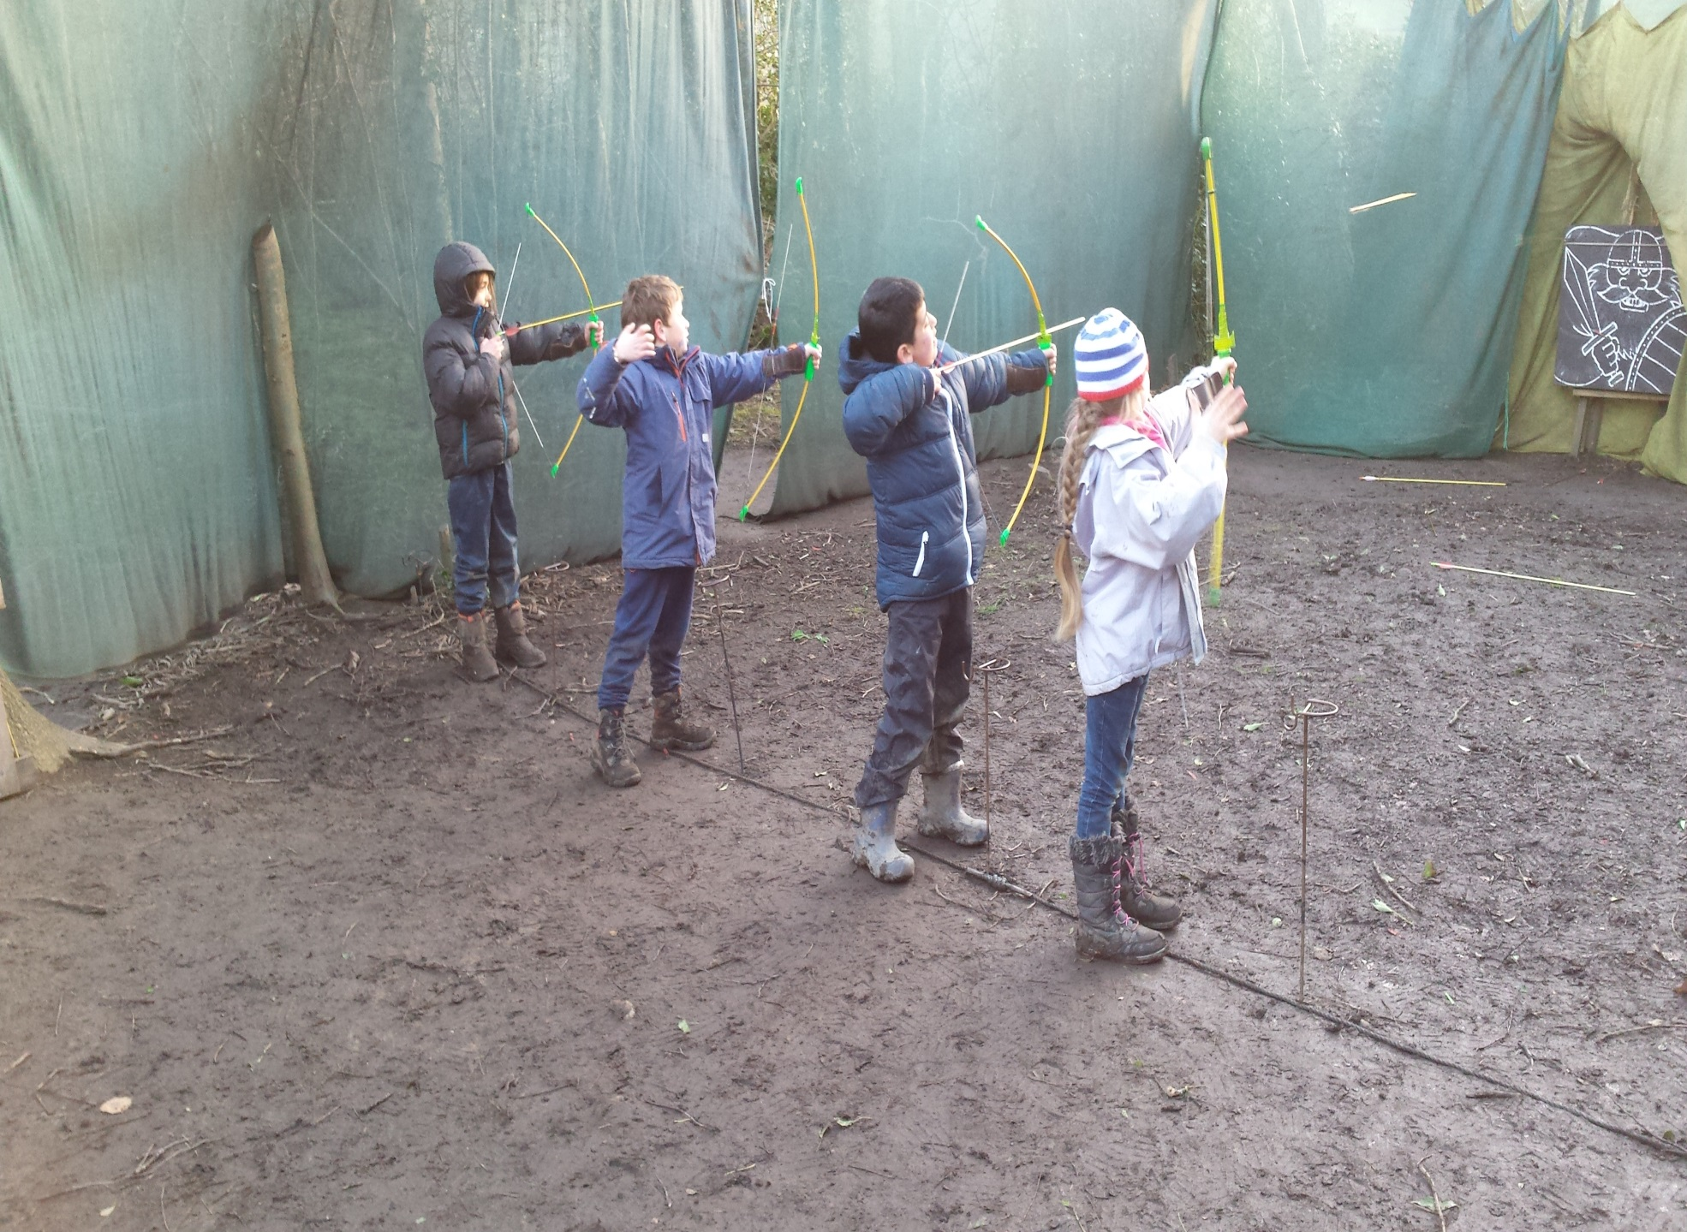

Slide 18
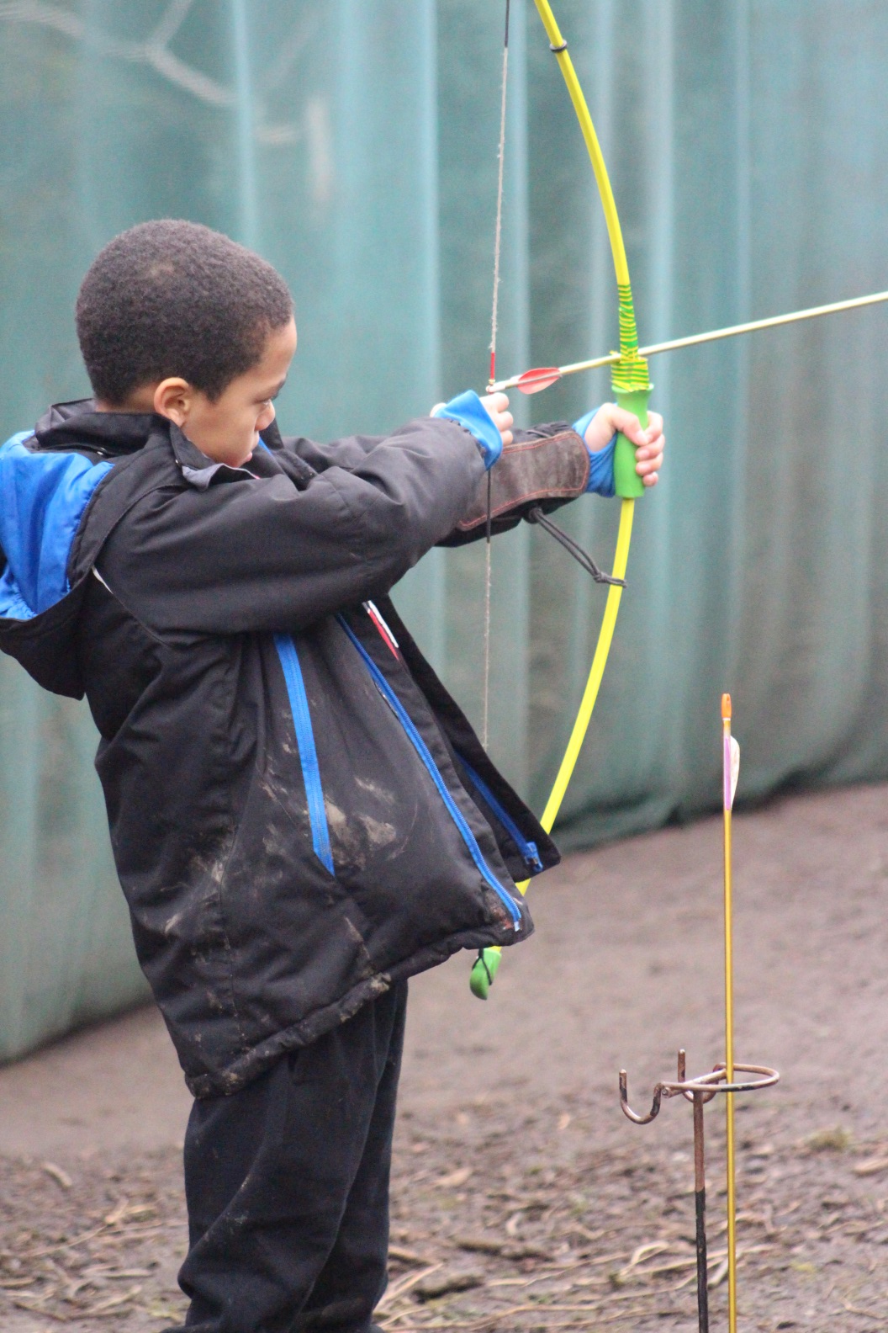

Slide 19
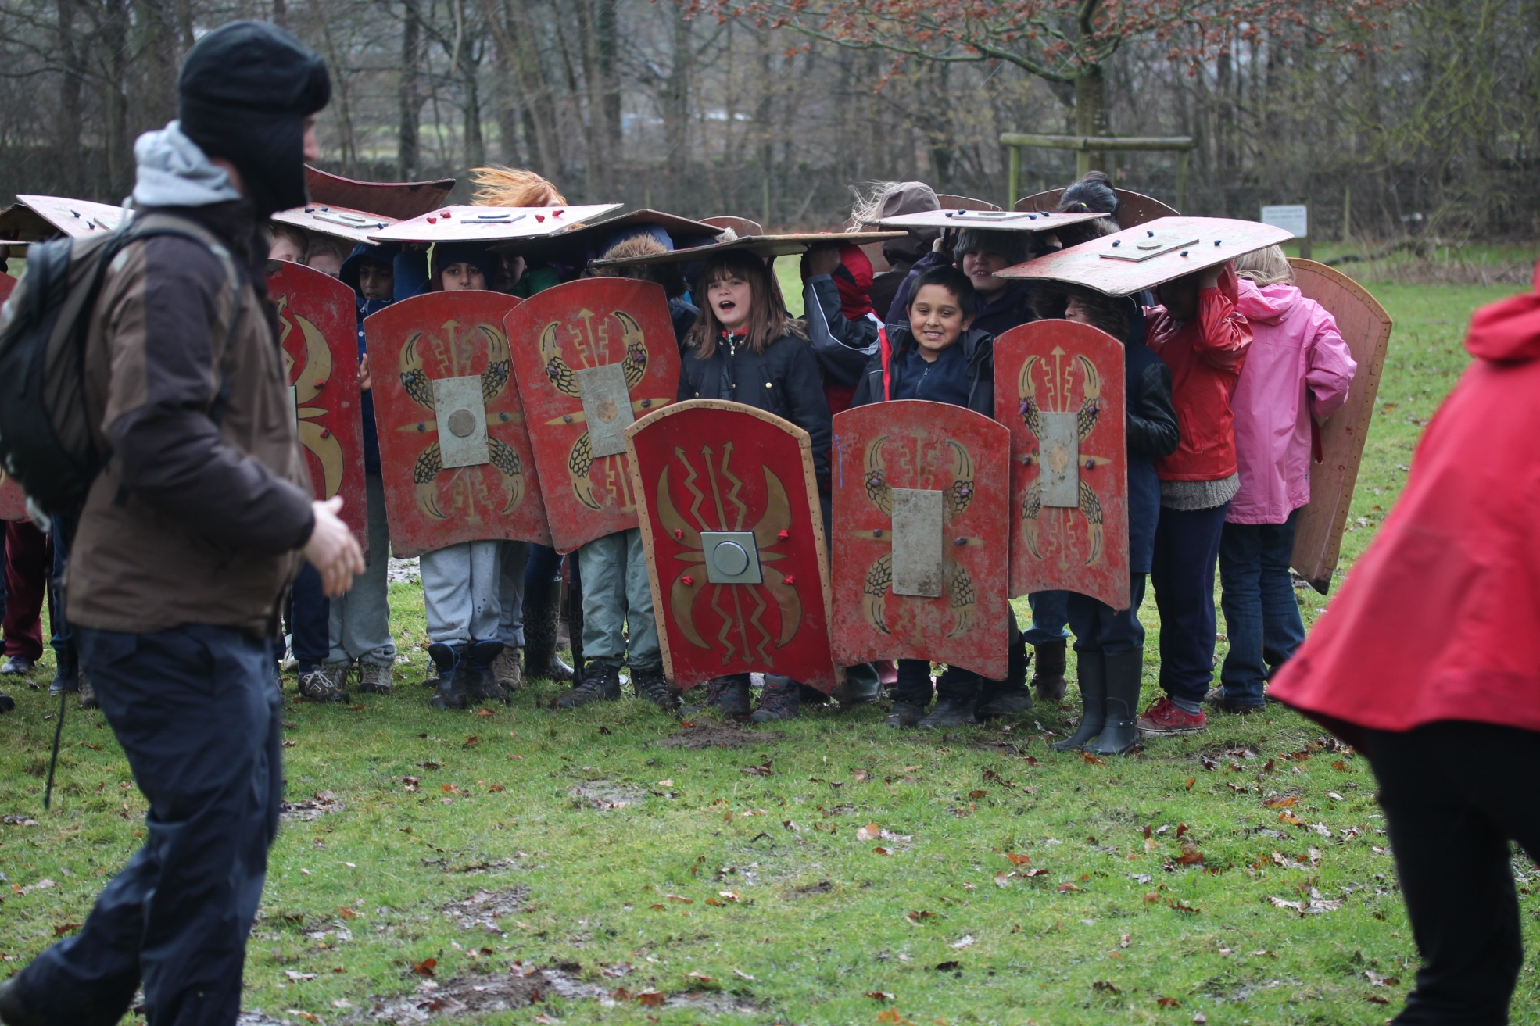

Slide 20
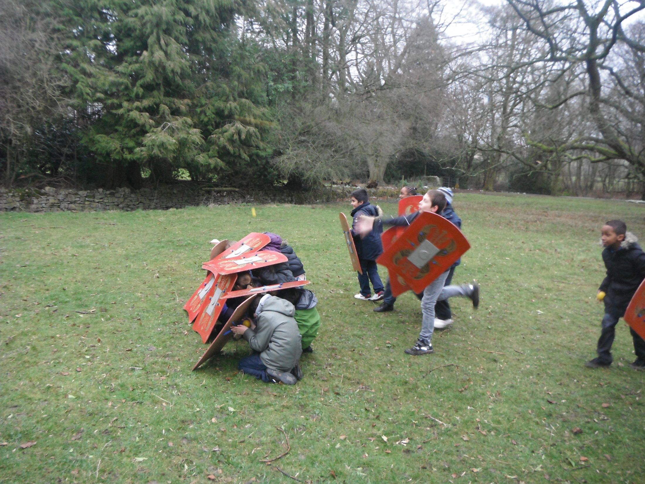

Slide 21
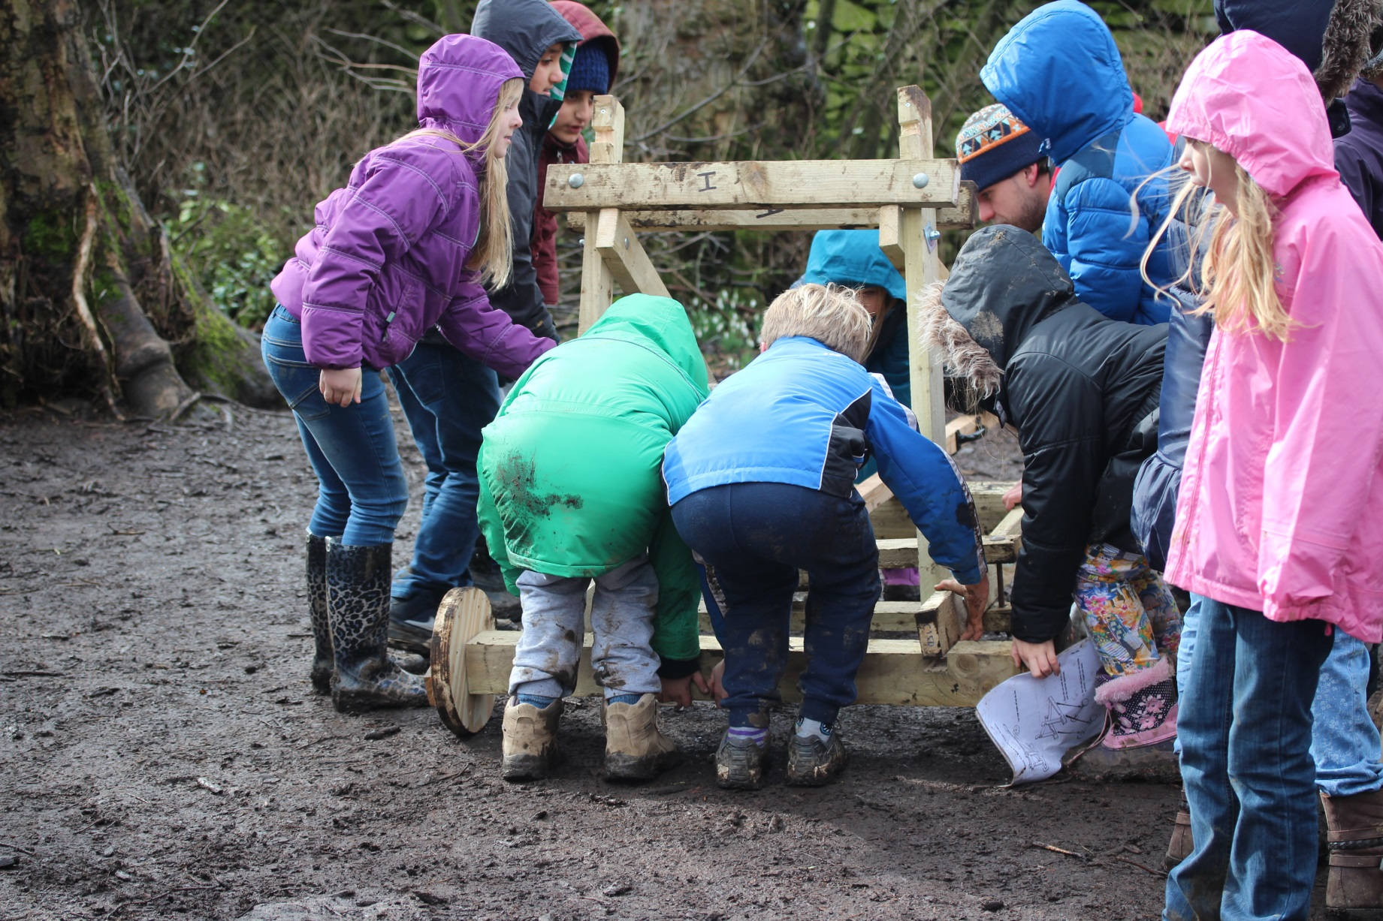

Slide 22
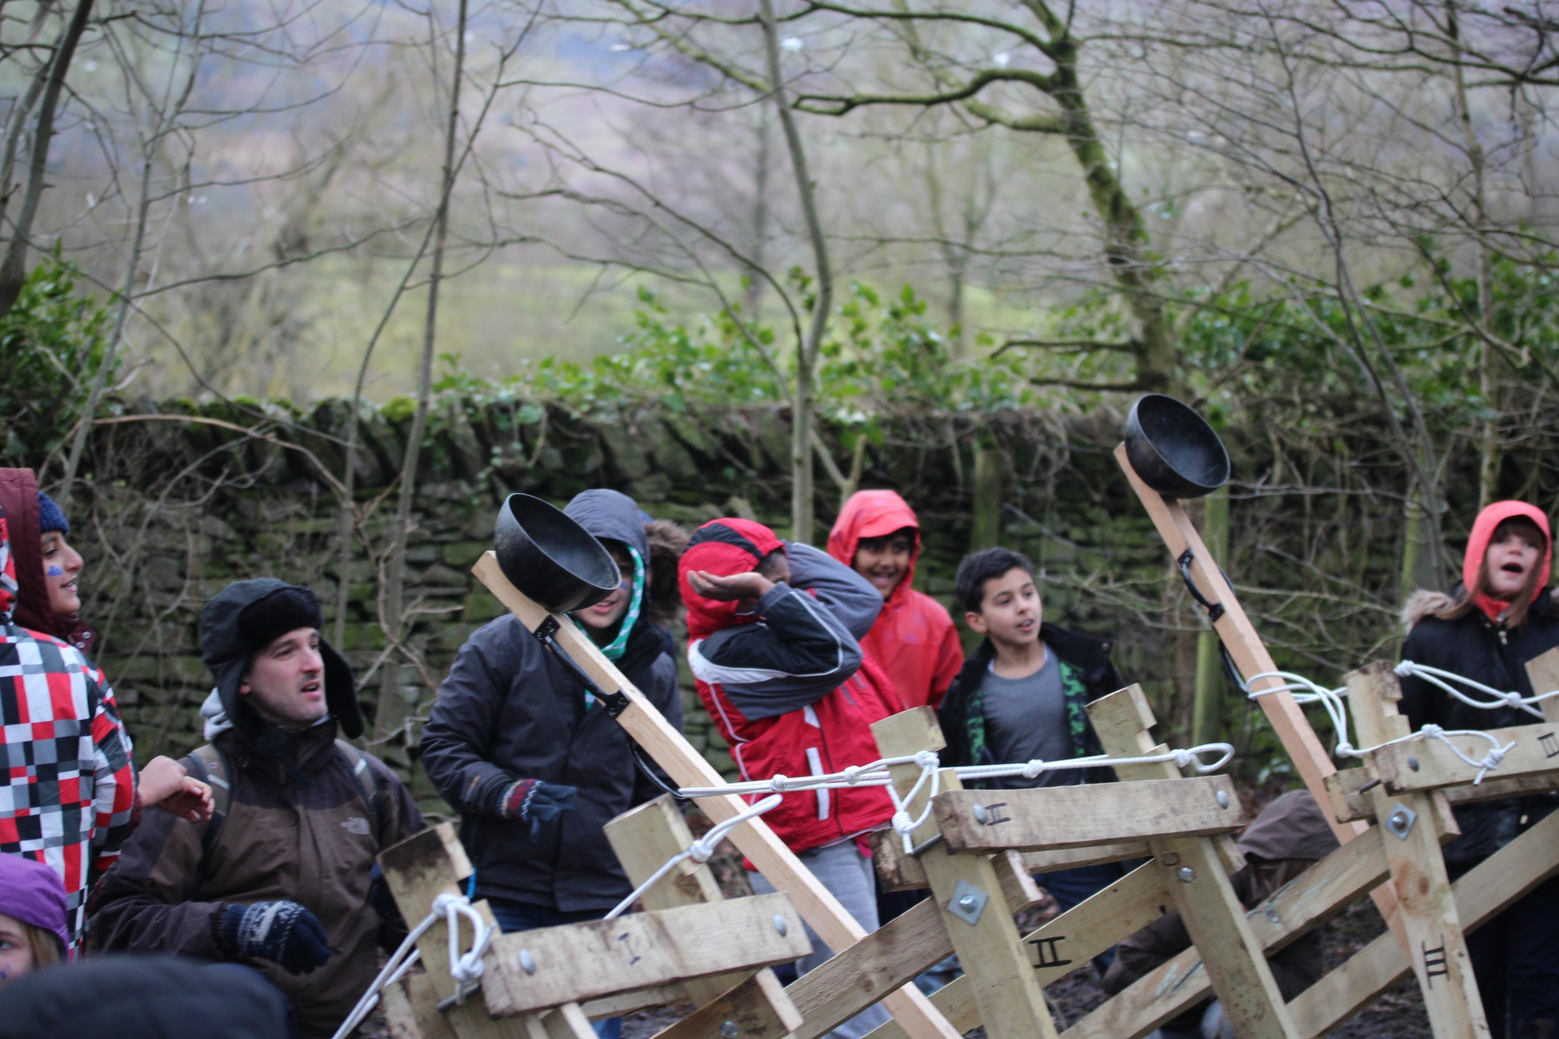

Slide 23
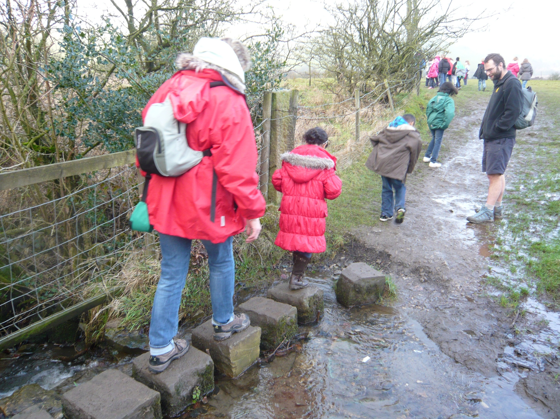

Slide 24
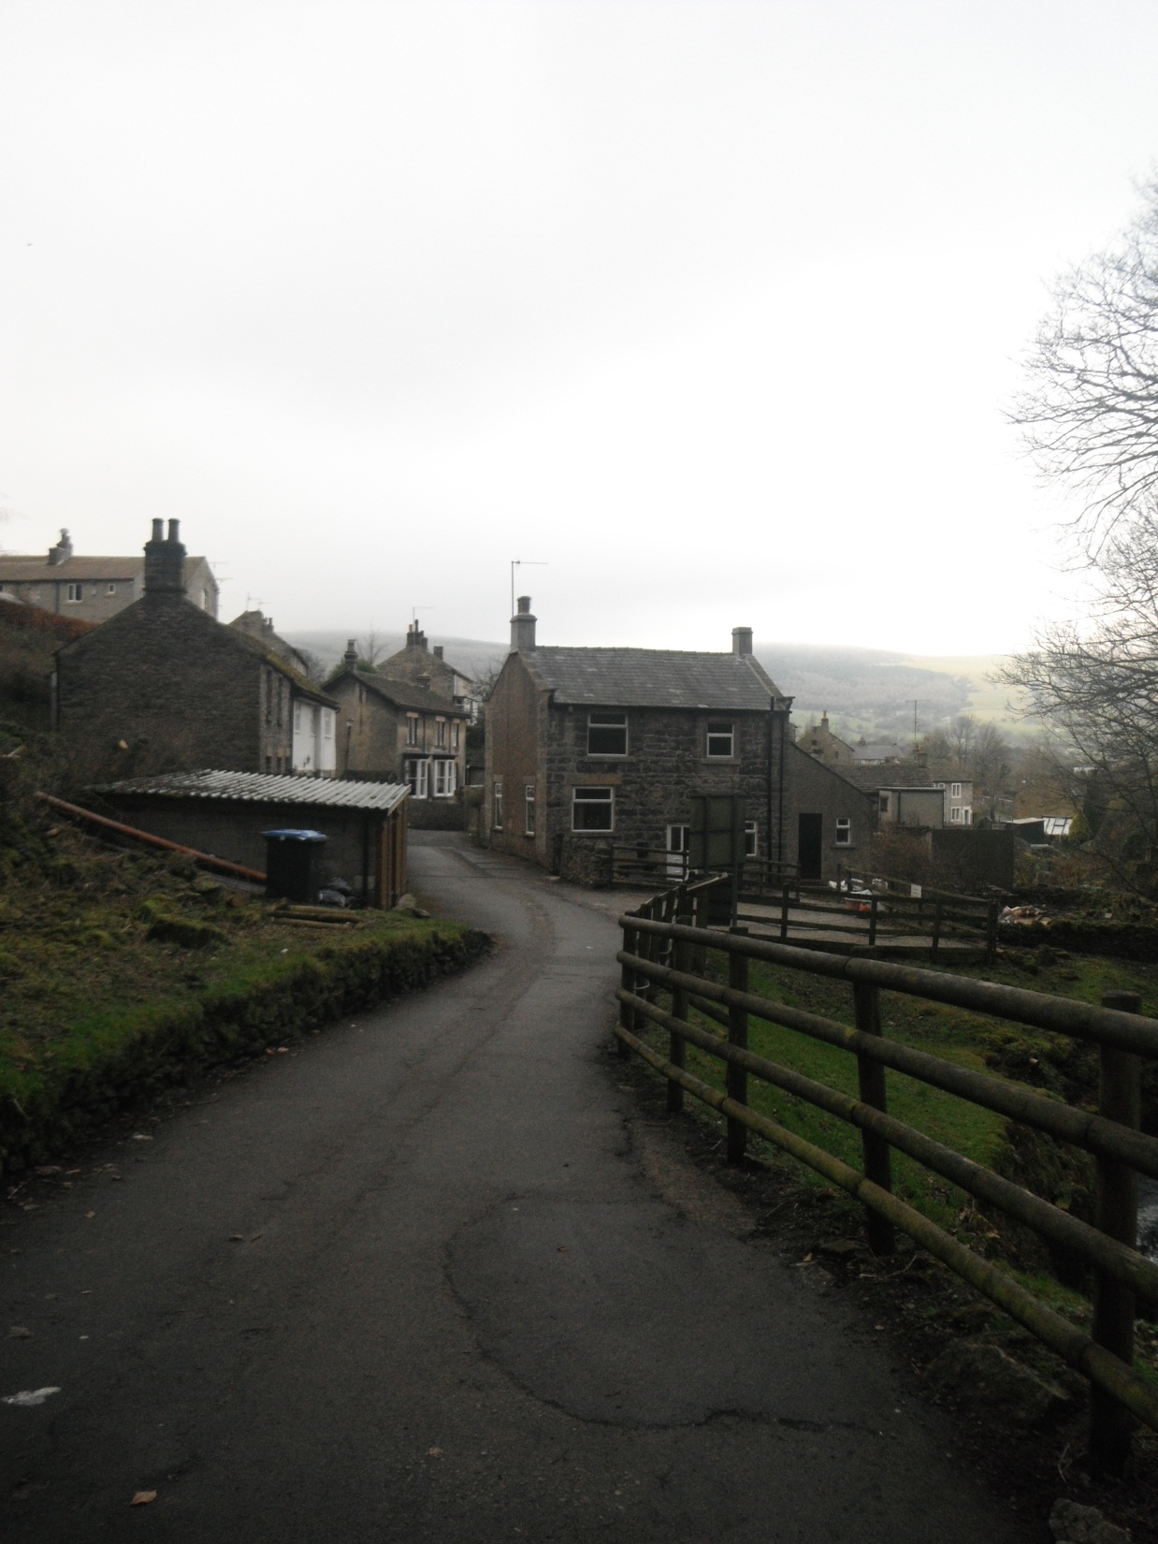

Slide 25
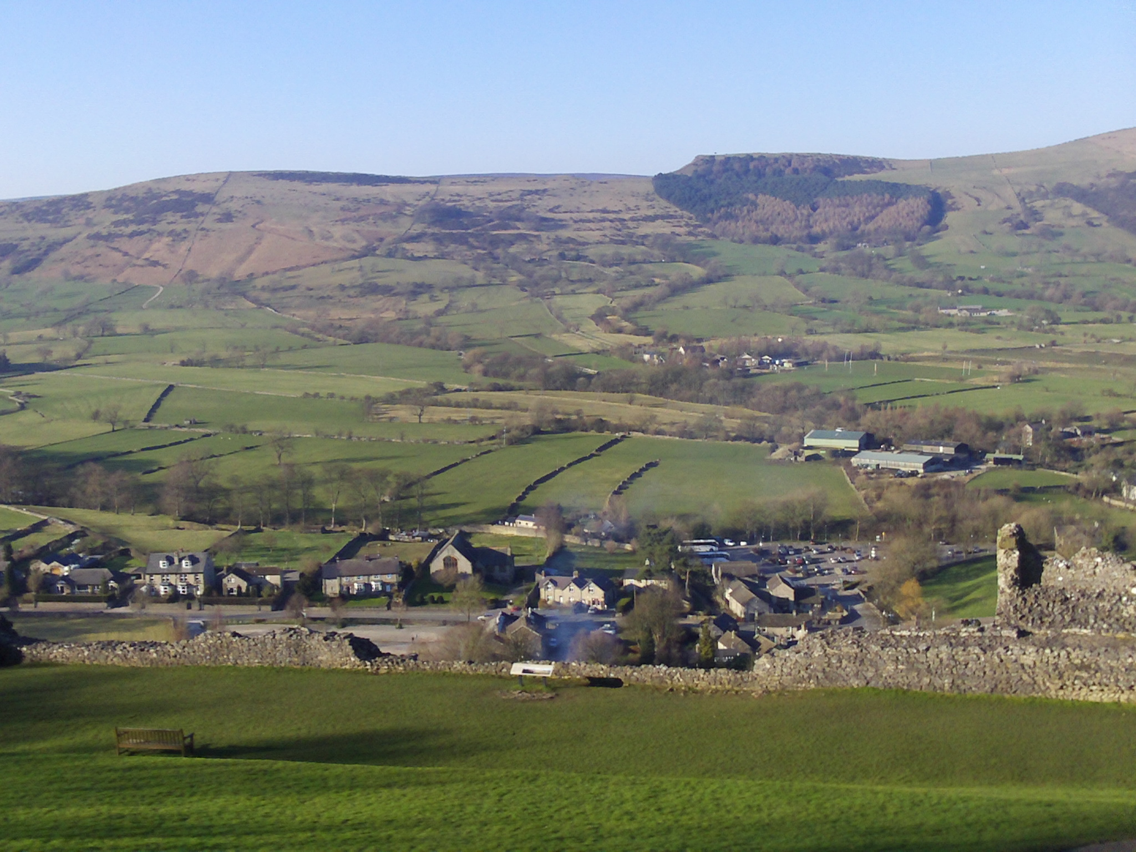

Slide 26
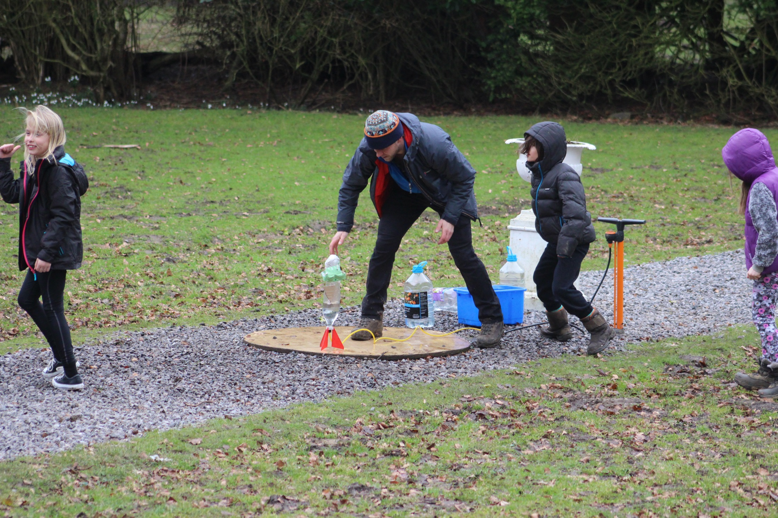

Slide 27
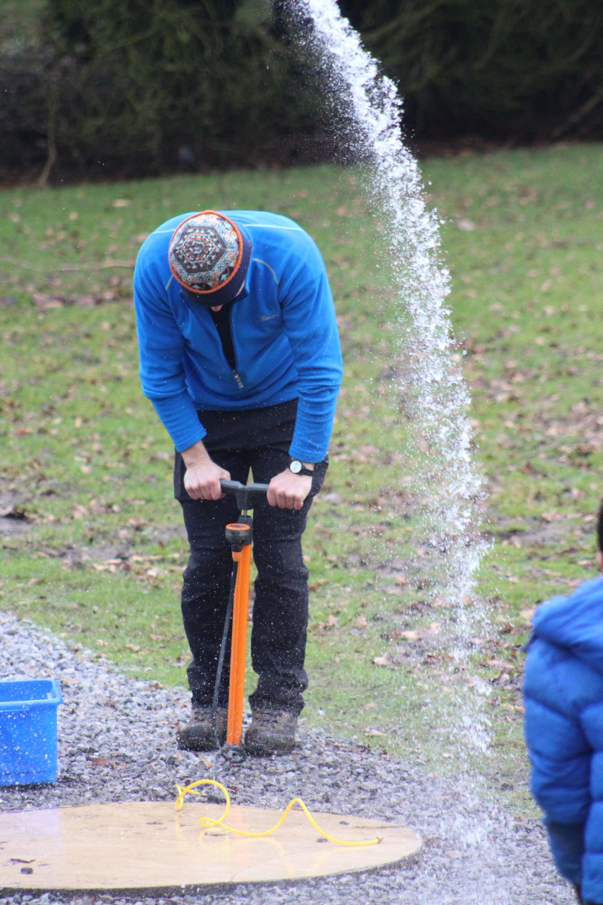

Slide 28
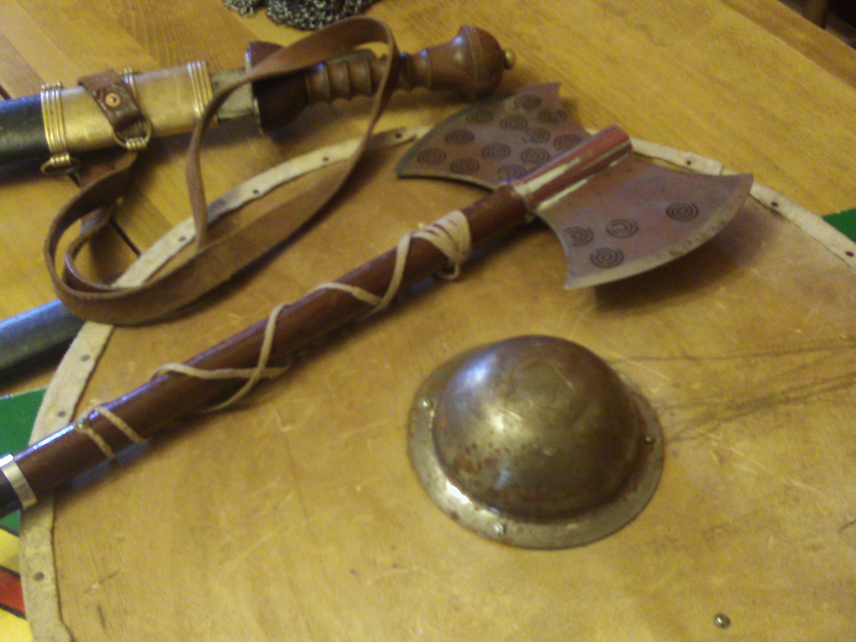

Slide 29
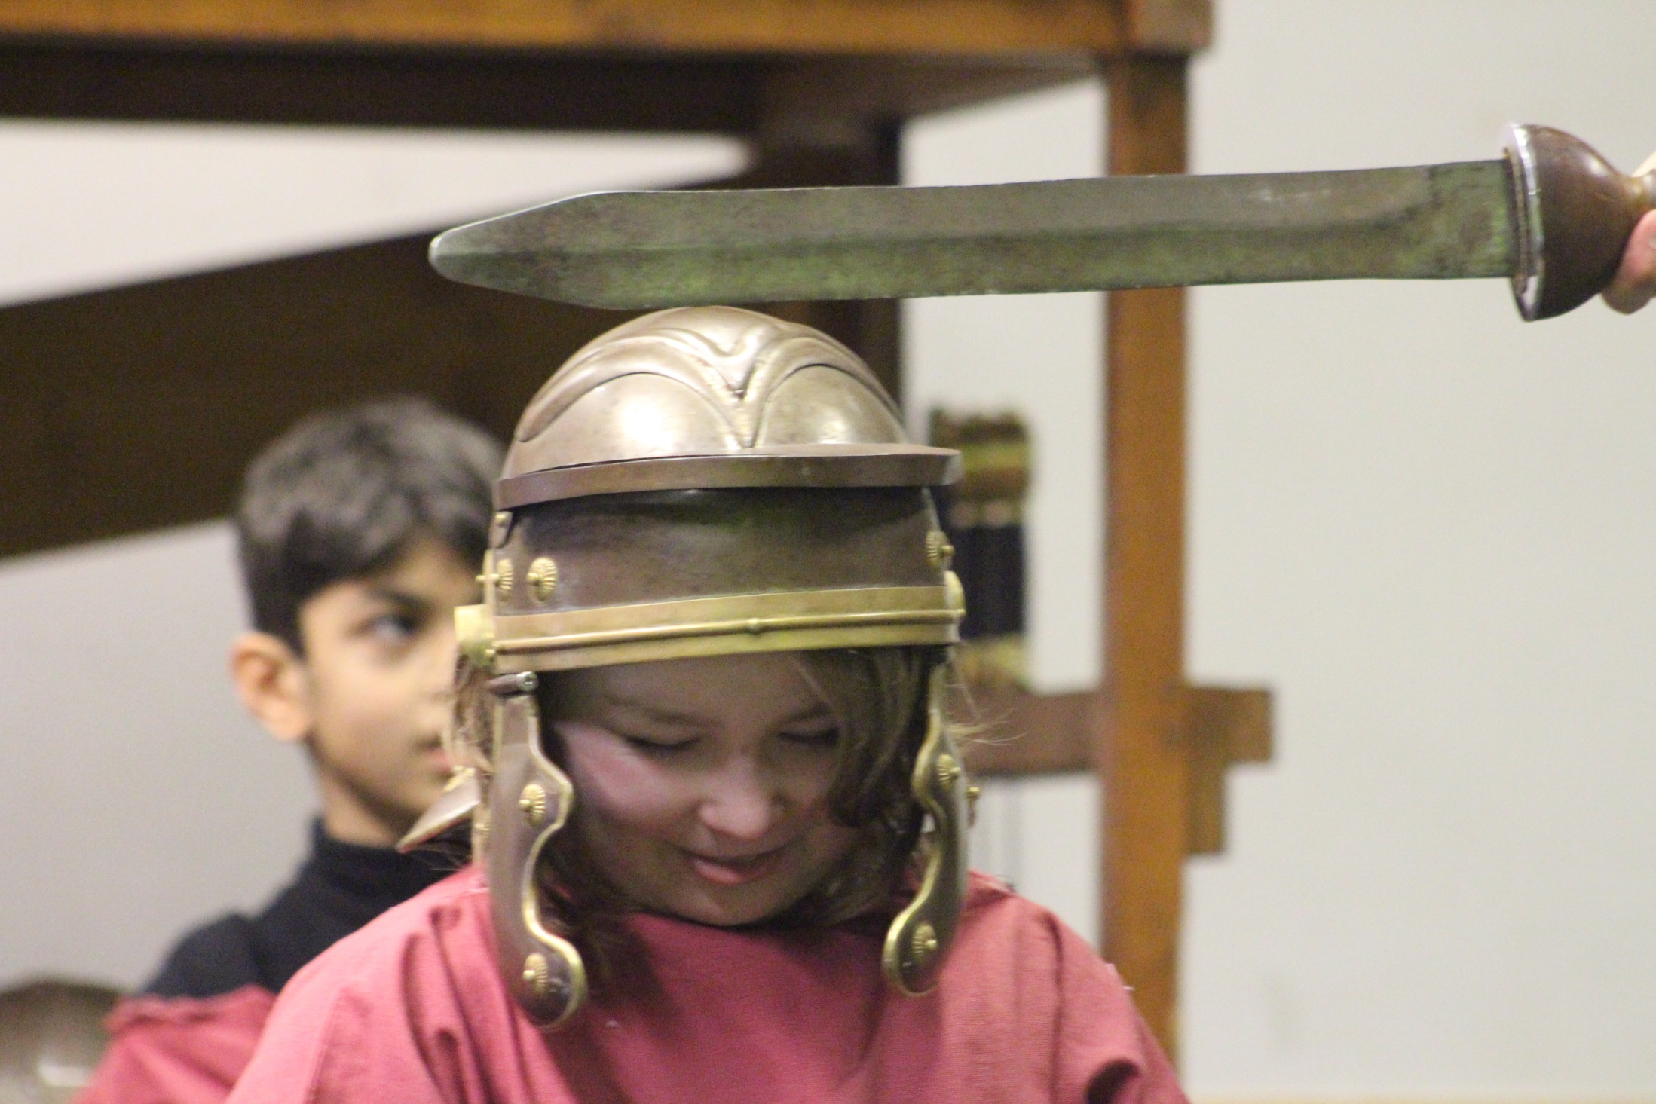

Slide 30
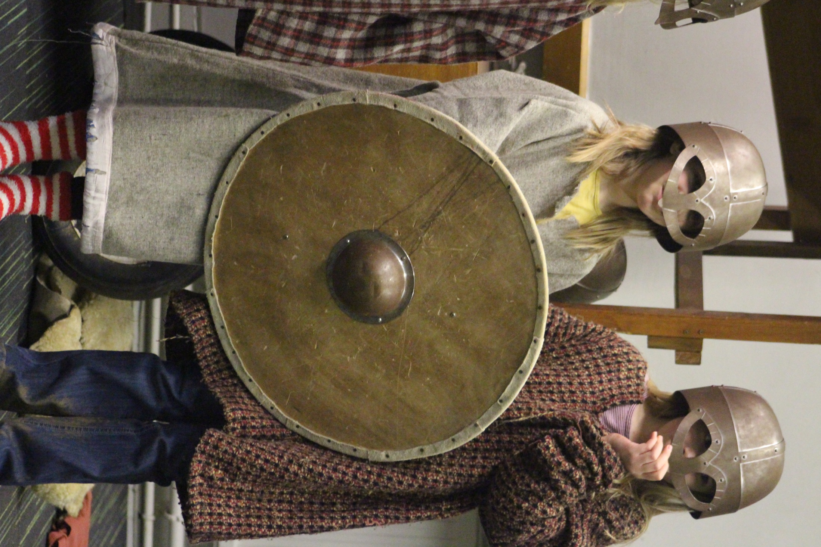

Slide 32
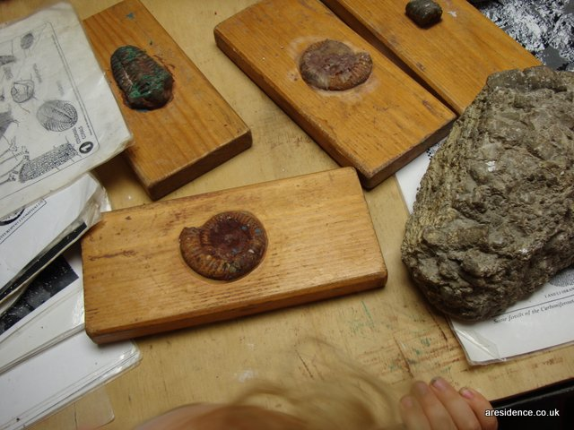

Slide 33
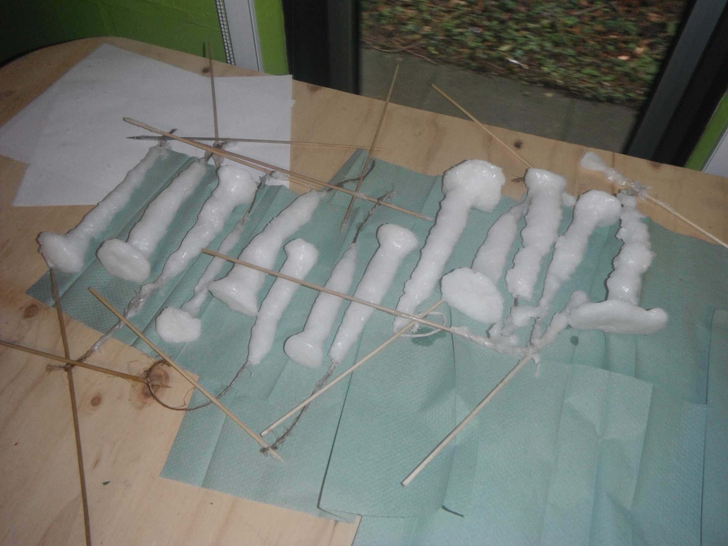

Slide 34
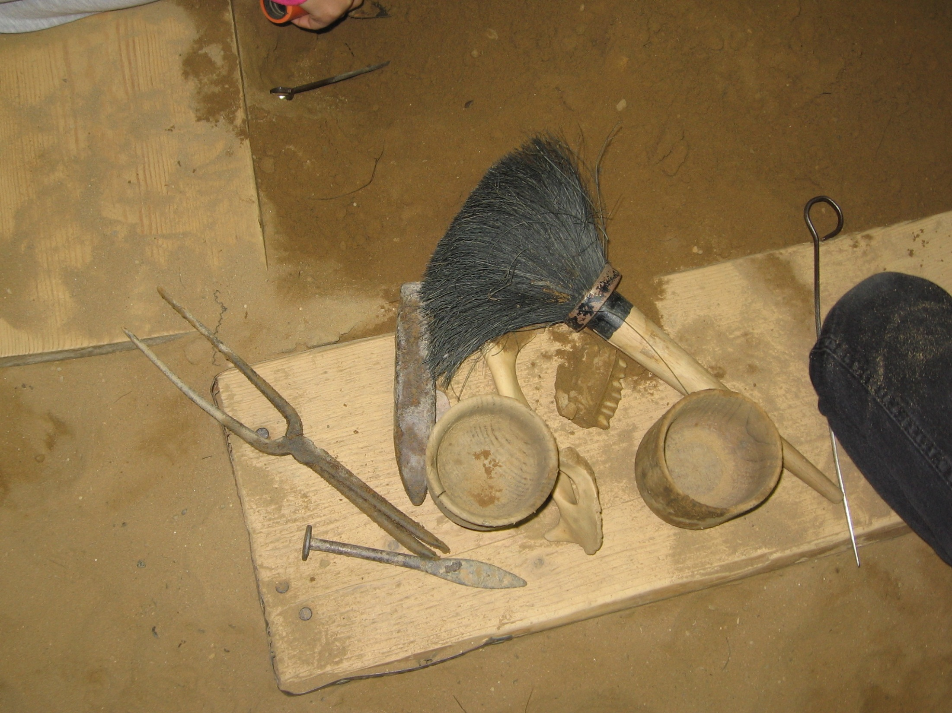

Slide 35
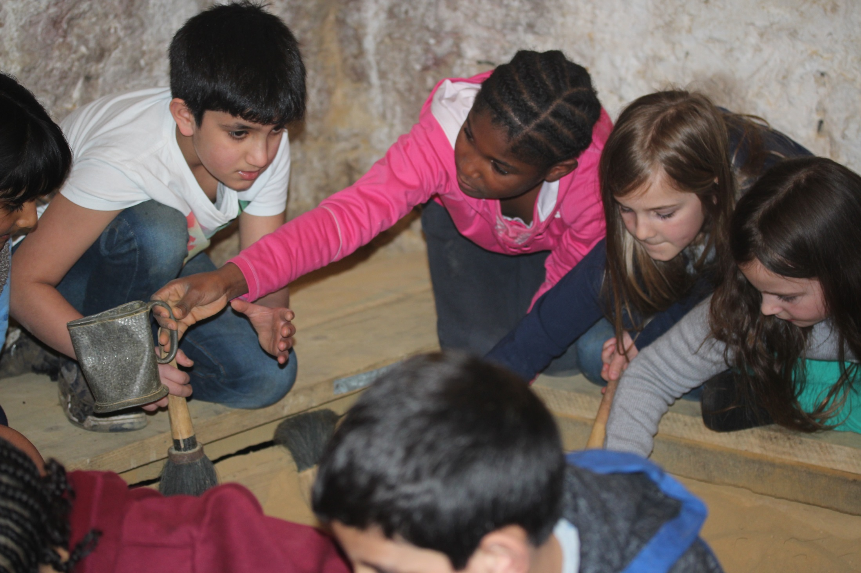

Slide 36
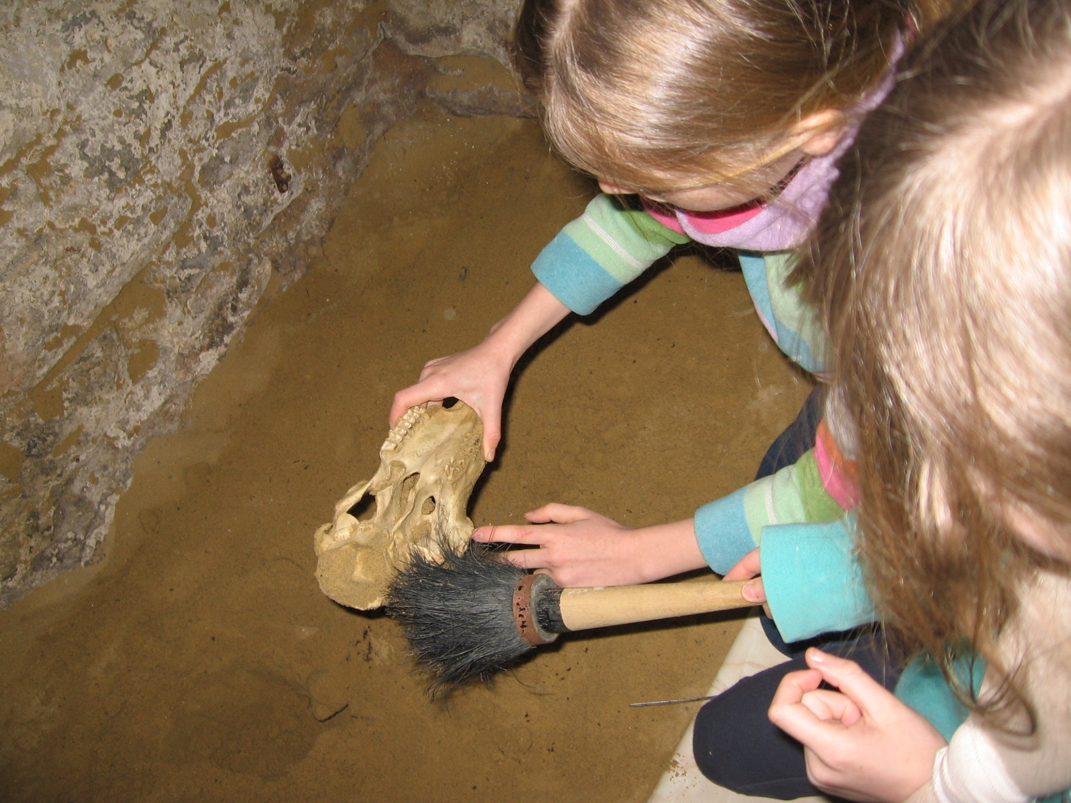

Slide 37
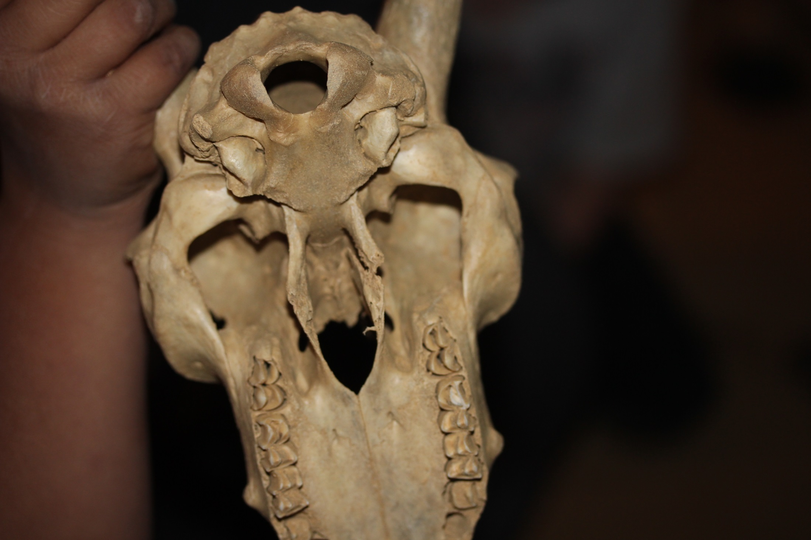

Slide 38
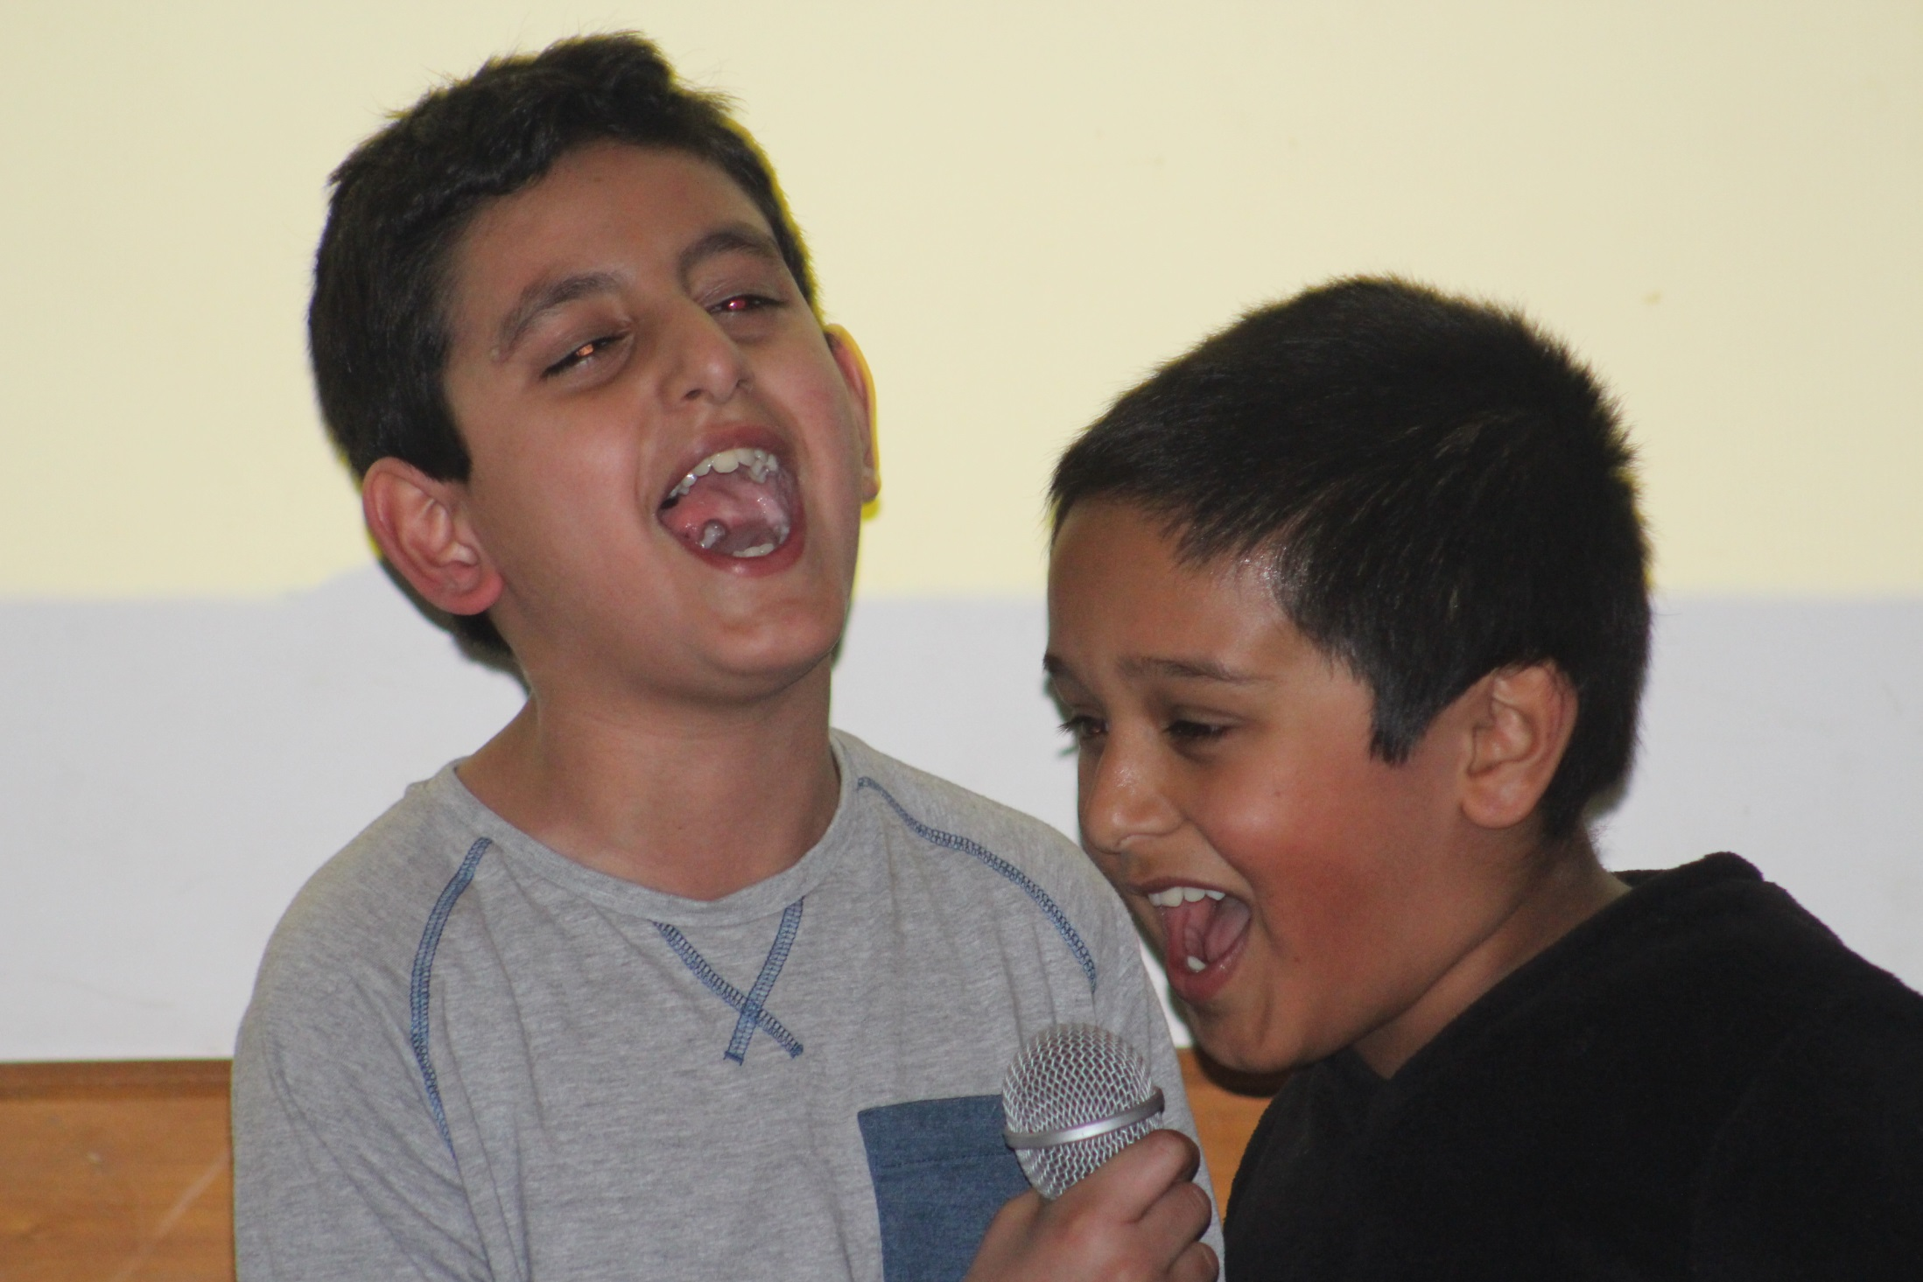

Slide 39
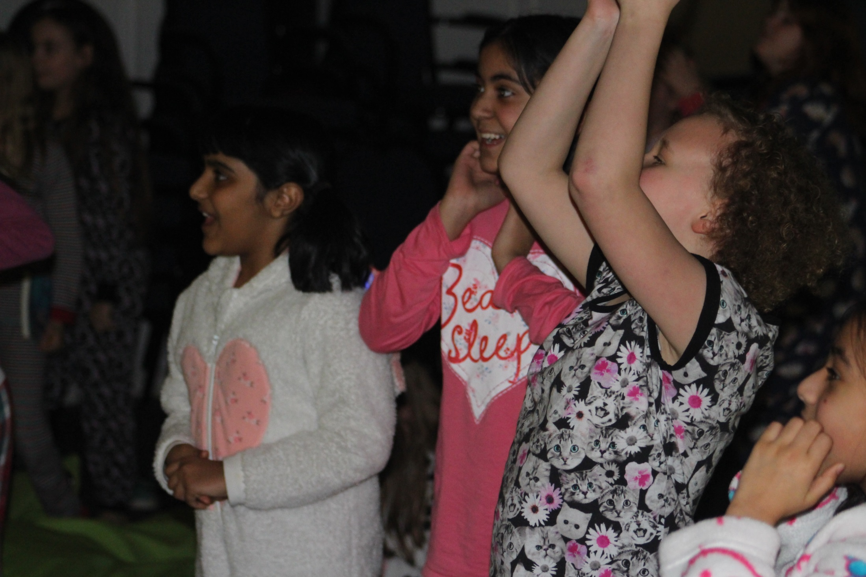

Slide 40
Thank you
Any questions?

