Slide 1
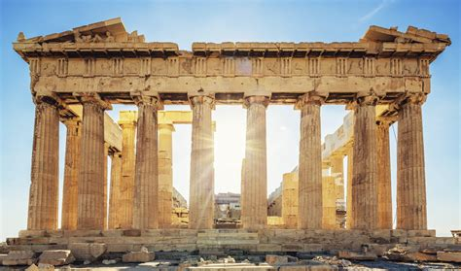
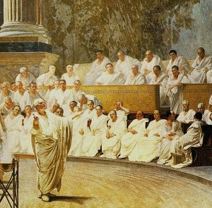
The world we live in has been shaped by ancient Greek civilisation | Year 3| Summer 1
Powerful knowledge to know and use
1 | We see Greek influences today in buildings, politics and sport.
2 | We live in a democratic country where people’s voices are listened to.
3 | Every four years the Greeks held a special sporting and religious festival called the Olympic Games. We still have these!
4 | We can study our local area to see how it has changed through time.
5 | Socrates and Plato were philosophers (thinkers). Like us in P4C, they asked 'chewy’ questions about life that do not always have a correct answer.
6 | Ancient Greek stories are still told today. We love films about superheroes and monsters. TV shows are full of stories about long-lost children returning to find their parents - just as ancient Greek plays were.
7 | Herodotus was known as the ‘father of history’. He wrote a history of the Greeks. He used eyewitness reports, something today’s historians also try to do.
8 | Law is a set of rules designed to keep people safe and at piece with one another
Lines of inquiry
How has ancient Greece shaped sport in the world? What is democracy? How has ancient Greece shaped our urban environment?
Tier 2 words you need to remember and use in your work
1 | Democracy | A democracy means ‘rule by the people’. Here, people can take part in the decisions that affect the way their community is run.
2 | Influence | The power to change someone or something. Another verb for this is ‘shape’.
3 | Society | A community of people living together and having shared ways of living. For example, Greek society and British society.
4 | Change | To make or become different. How has sport changed since ancient Greek times? How has the General Cemetery in Sheffield changed since 1836?
5 | Evidence | Anything that can be used to prove something. For example, a piece of art from ancient Greece can be used as evidence.
6 | Design | To make drawings, sketches, or plans.
7 | Compare | To look at two or more things closely to see what is similar and different about them.
8 | Civilisation | A particular society at a particular time and place. For example, the ancient Greek civilization.
9 | Urban | Used to describe life in a city. For example, You live in an urban area – Sheffield!
Key images

